Slide 1
AEMR Case Study – Executive Presentation
Lokesh Mamidisetti

Slide 2
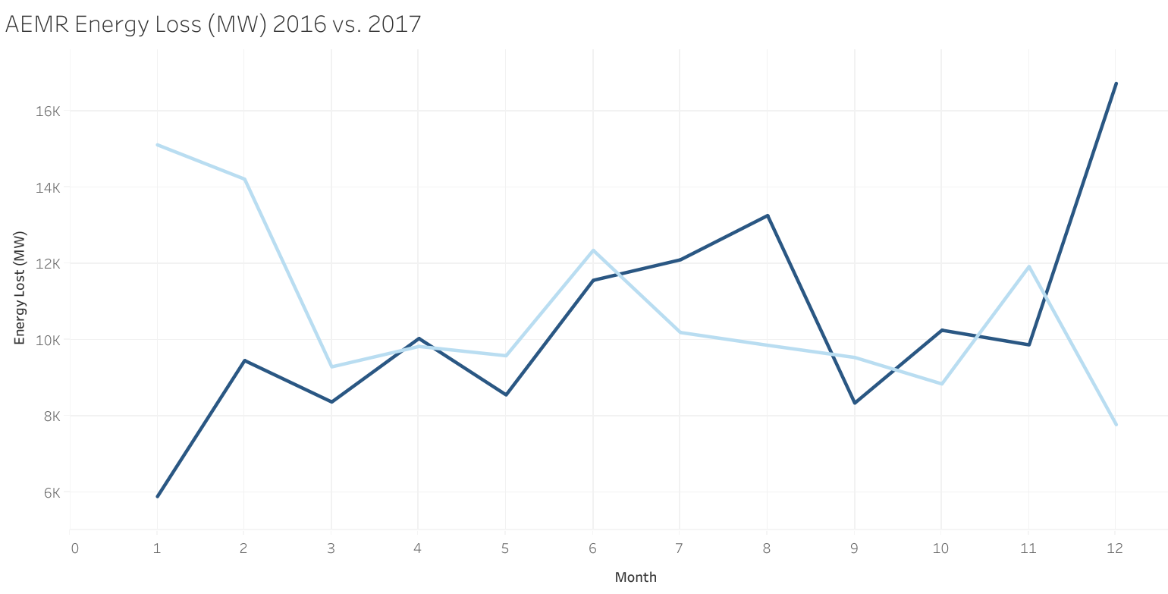
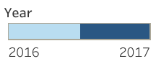

While energy loss trends are consistent YoY, December’17 experienced a 115.4% increase in energy loss (MW) compared to December ‘16, indicating plant inefficiencies due to outages
2016
2017
Total Energy Loss: 128K MW
Total Energy Loss: 124K MW
Dec. Energy Loss: 7K MW
Dec. Energy Loss: 16K MW
Avg Loss: 26K MW
Avg Loss: 23K MW
Key Insights
The 115.4% increase in energy loss during December was caused by number of outage events in AURICON increasing by 84 (763.6%) thereby increasing energy loss by 5,997 MW (460.9%).
Overall total energy loss decreased by 4K MW despite the sharp increase in the December month which indicates December experienced an increase of unplanned (forced) outages which was also caused by the AURICON provider
Source: AEMR Data 2016 - 2017

Slide 3
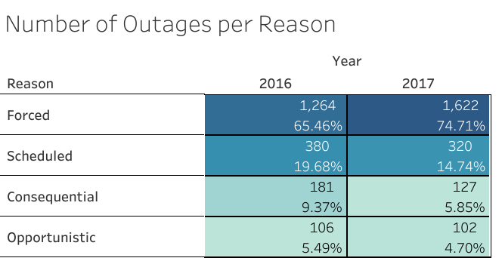
Plant outages increased overall YoY, with Forced outages accounting for over half of the total in 2016 and 2017
Key Insights
Forced outages increased by about 9% YoY which indicates there is likely an issue with the functionality of one or more of the operating plants
The high number of forced outages can be a cause for concern because it is unpredictable strain on the entire network. Efforts should focus on minimizing the number of forced outages in the upcoming year
Source: AEMR Data 2016 - 2017

Slide 4
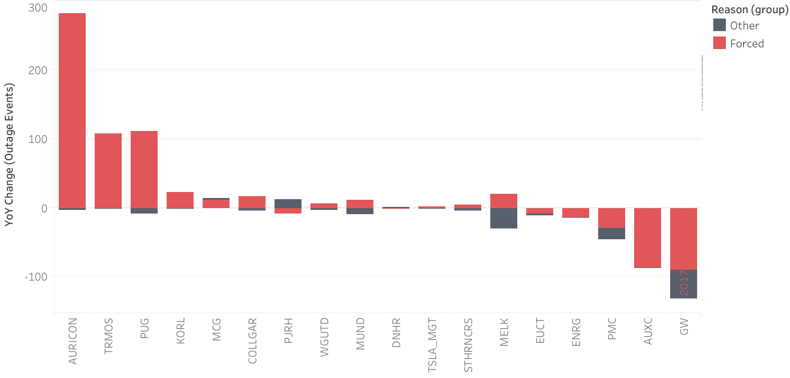
AURICON has the highest increase of total outage events (93.6%) and the highest increase of forced outages YoY of all participants (135.6%)
Number of forced outages vs. all other categories (consequential, opportunistic, planned) by participant code
Key Insights
Not only did AURICON see the highest increase in overall outage events, but an overwhelming majority of those were forced outages, with an increase of 282 (135.6%) YoY
Since forced outages are unplanned these factors point to AURICON as the most unreliable energy provider in the network
Source: AEMR Data 2016 - 2017

Slide 5
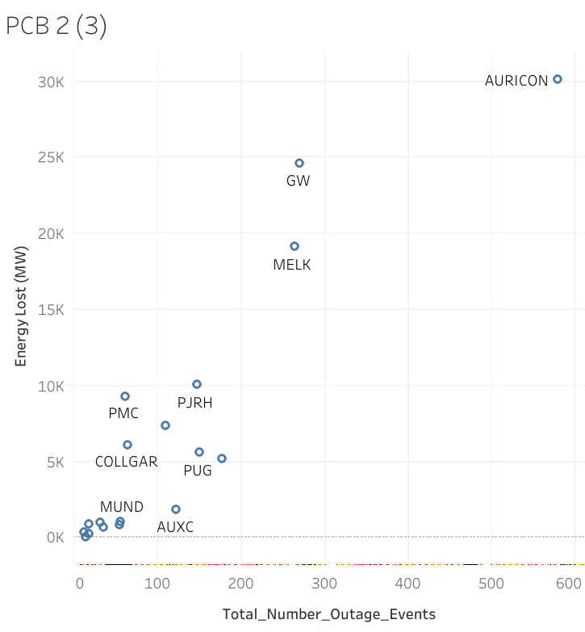
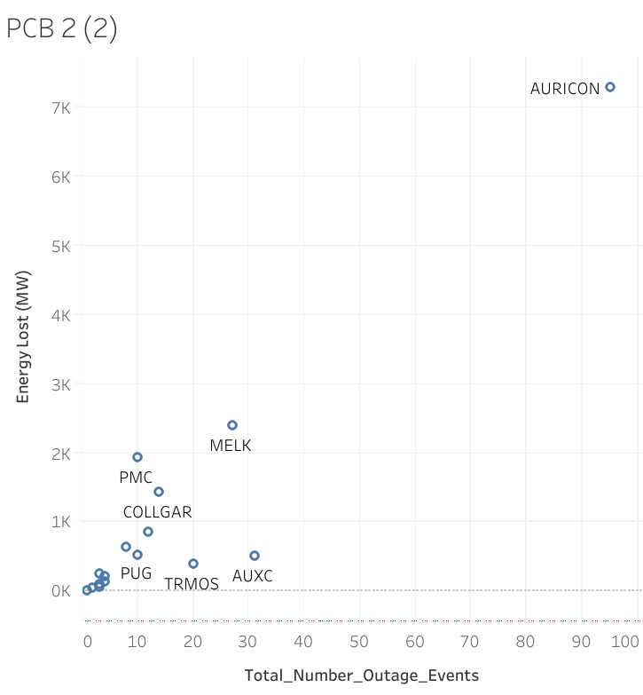
AURICON proves to be the largest source of energy loss and outage events in December’17 as well as the full year of 2017 when compared to the performance of all other providers
Participant’s energy loss (MW) and total outages; 2017 vs. Dec. ‘17
Full Year, 2017
December 2017
Key Insights
Drilling down to just December, AURICON proves to be the anomaly that caused the sharp decline seen in the monthly breakdown of energy loss
AURICON drove the bulk of energy loss not only in December, but also for the entirety of 2017, and should therefore be inspected for efficiency improvements or other root causes of an outage to mitigate its strain on the functionality of the network.
Source: AEMR Data 2016 - 2017

Slide 6
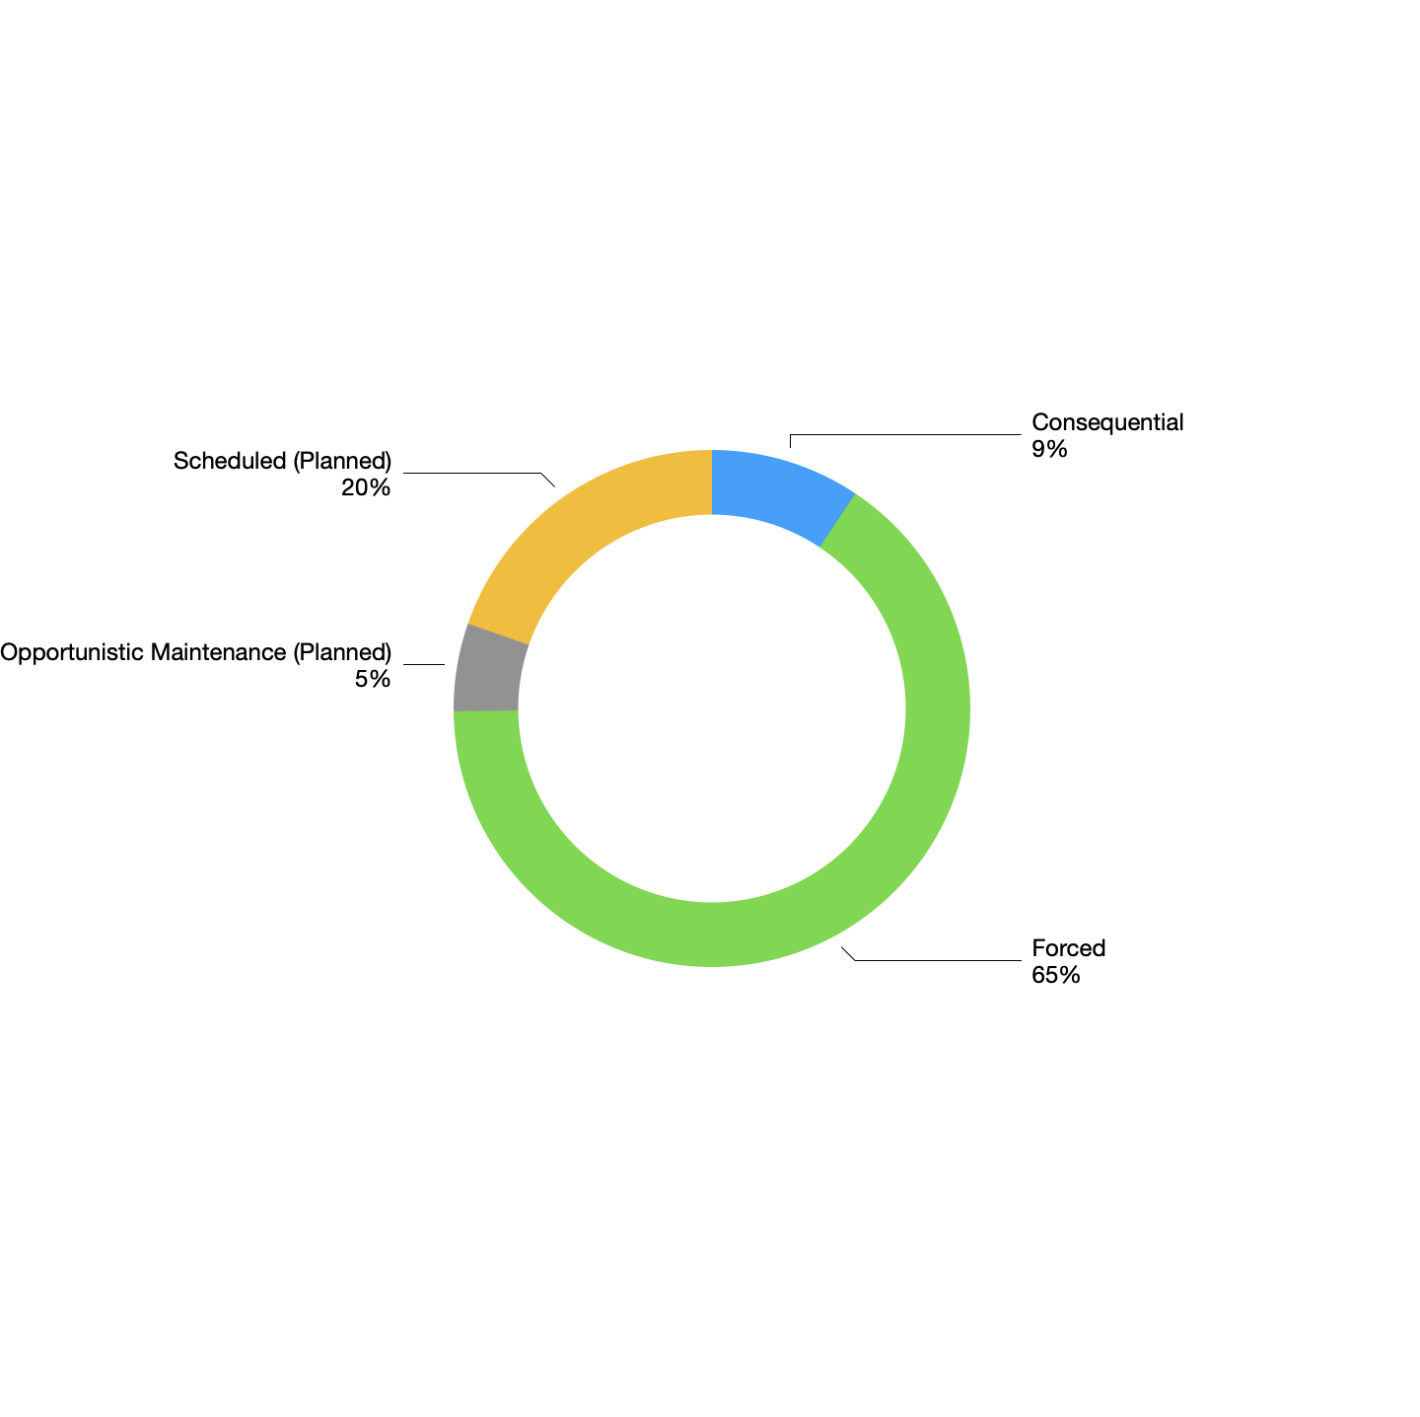
1.1

Slide 7
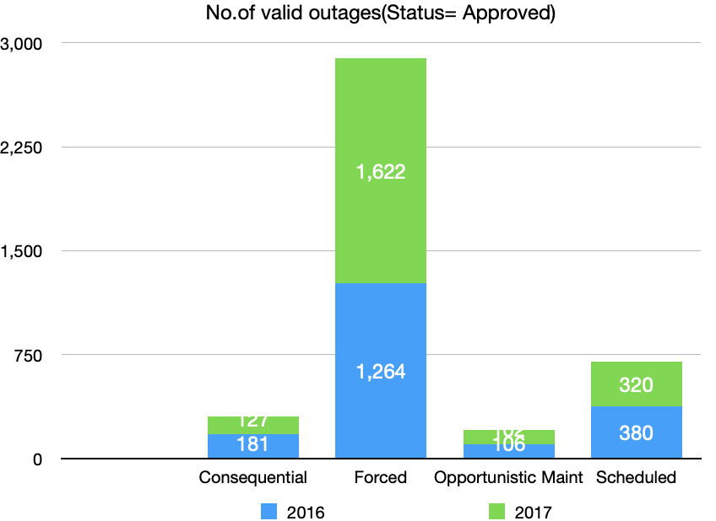
1.1 - 1.3

Slide 8
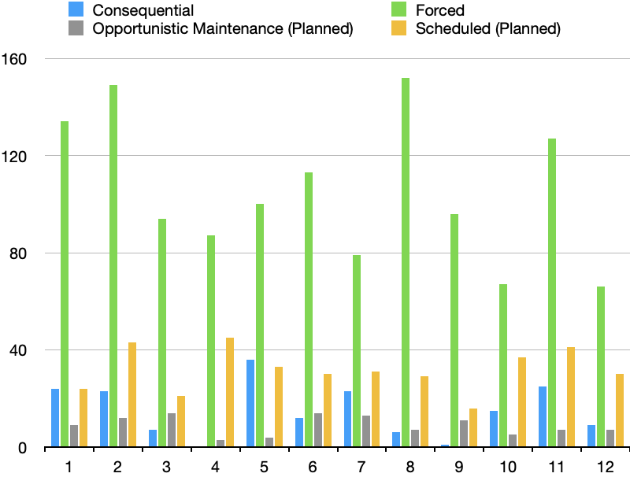
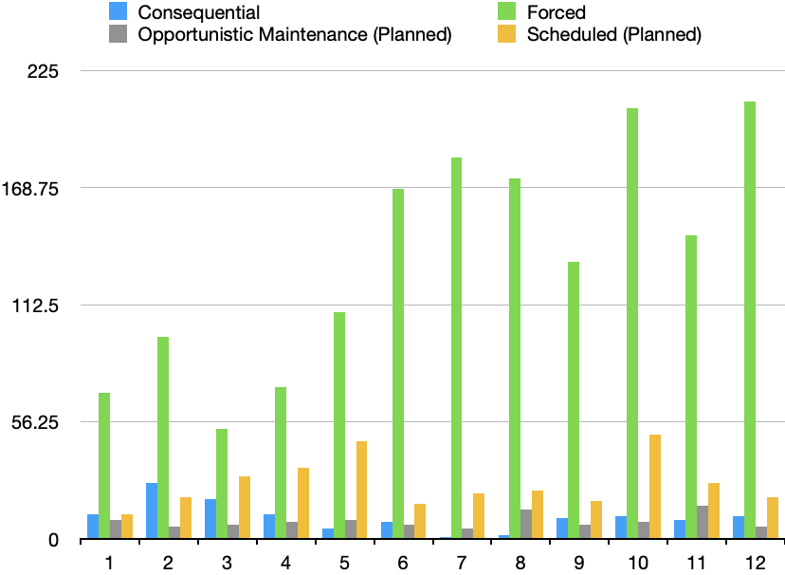
2.1,2.2
Total Number Outage Events

Slide 9
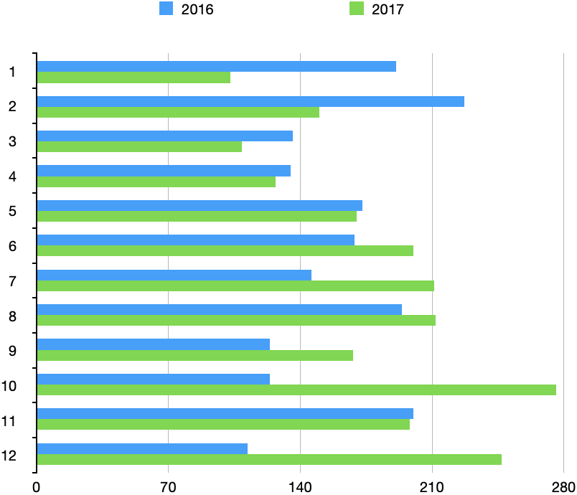
2.3

